Slide 1
HCP Journeys at Galapagos Intro, Value & Progress
April ‘21

Slide 2
Why OC HCP journey are important to Galapagos ?
The traditional methods of engaging with HCPs no longer meets physician needs, and Galapagos aims to engage differently.
Galapagos is working in a highly competitive landscape, but has potential to differentiate itself by delivering a segmented HCP experience
HCP Journeys are the tool by which segmented customer experiences are designed, creating value for customers and differentiation vs competitors.
HCP Journeys are also an effective way to align the sales, marketing, and medical functions effectively, connecting strategy to execution.
Clear and consistent HCP Journeys are the foundation of more advanced marketing techniques

Slide 3








Value of the HCP Journey
HCP Journeys are the tool by which this personalisation* is designed, creating value for customers and differentiation vs competitors.
How HCP Journeys Create Value
How They Enable Launch Execution
Focusing on journeys rather than touchpoints is correlated to higher customer satisfaction & revenue growth1
OC HCP Journeys collect & visualize…
Content
What is being said to an HCP
HCPs satisfied with their journey for a drug & the pharma company’s contribution to it are 2x more likely to prescribe than dissatisfied HCPs.1
Channel
How it is being delivered
Personalization across industries reduces acquisition costs by 50% and increases efficiency of marketing spend by 10-30%.2
Adoption Ladder
When it should be said
Segmentation
How this varies between HCPs
Customers gain the ability to see the right information at the right time, in their preferred channel
…Into one executable view
McKinsey - From product to customer experience: The new way to launch in pharma
McKinsey- Marketing’s Holy Grail: Personalization at Scale
*Personalisation here is defined as the ability to deliver on segmented engagements, meaning the message, timing and channel is tailored to each HCP.
Notes:
HCP journeys are the tool by which you design personalized customer engagements to unlock value at J launch
Move VALUE to the right – have three value for galap in one color, value for customers in another color
How does the journey unlock value: Journeys provide visualization of channels, content, adoption ladder into one executable view.

Slide 4
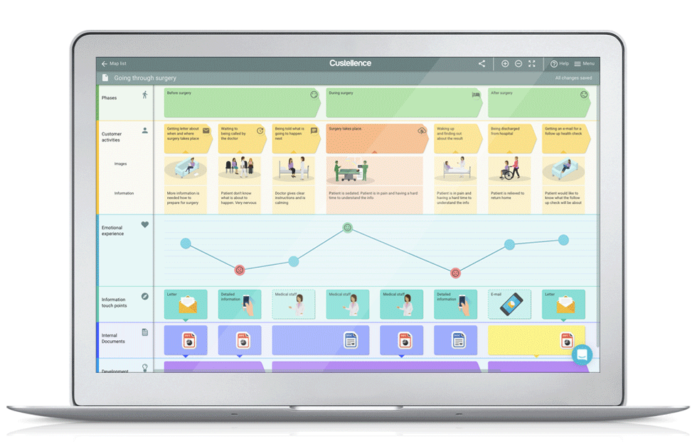

Value of the HCP Journey
HCP Journeys are also an effective way to align the sales, marketing, and medical functions effectively, connecting strategy to execution.
Sales
Medical
Marketing
The also demonstrate How to leverage the core channels, how to increase the number of touchpoints for improved SOV, and how to connect the physical and digital
HCP Journey
Illustrative
Having less resources than many competitors, we need to be much more accurate with our engagements in order to achieve these goals, the HCP Journey helps us to do this.

Slide 5

Why are HCP Journeys needed now?
The implications of not creating HCP Journeys now are substantial
Decreases potential for a successful JYSELECA Launch
Galapagos only has one chance to launch JYSELECA, and the use of HCP Journeys enables personalized HCP engagement, which stands as the best opportunity to differentiate against Galapagos’ heavily resourced competitors.
Prohibits intelligent marketing advancements
Clear and consistent HCP Journeys are the foundation of more advanced marketing techniques:
One message for all → Segmentation → Dynamic Channel Personalisation → Next Best Action → Automation

Slide 6
Building country-specific Omnichannel HCP Journeys to support Jyseleca

Slide 7

HCP Journeys Project
Jyseleca currently has a foundation of strategic planning related to customer engagement activities for launch, including detailed segmentation and market research.
A core team with the support of Veeva, are now focused on making the plan a reality, by converting these foundations into HCP Journeys that are practical and actionable at the local level to secure competitive share of voice and achieve success.

Slide 8
Omnichannel is not digital only
It is the combination of a seamless and connected experience for a customer….
…with tailored information, that is updated based on previous interactions…
…across all possible Galapagos touchpoints.
Our approach has the Rep as a key channel.

Slide 9

What will markets get at the end?
A clear, 12-month* Customer Journey for your market, for RA/IBD indication, linked to driving HCPs up the initial stages in the adoption ladder
Journeys that are linked to content both existing and currently in production for launch, with easy access to the materials needed for execution (and view on planned content)
An easy-to-use Customer Journey format, to enable dynamic updates throughout the year
*length is an estimate, journeys will likely be more focused around adoption stage TBD during week 1
**See project plan for market and indication delivery details

Slide 10



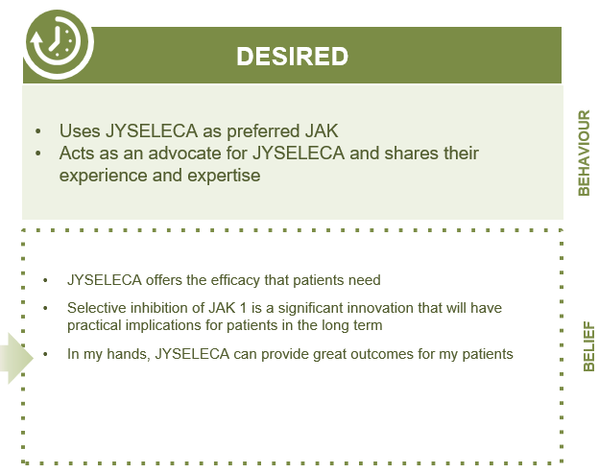






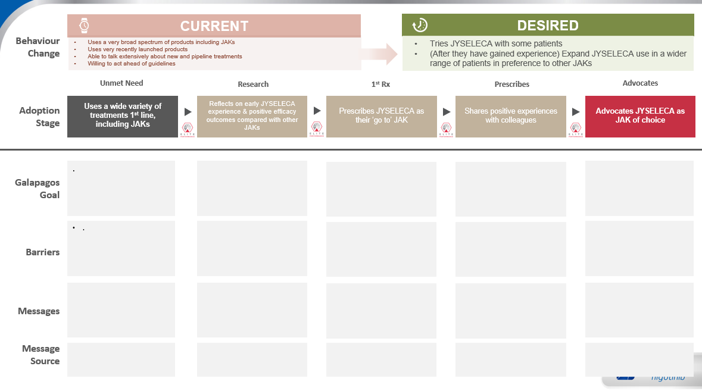
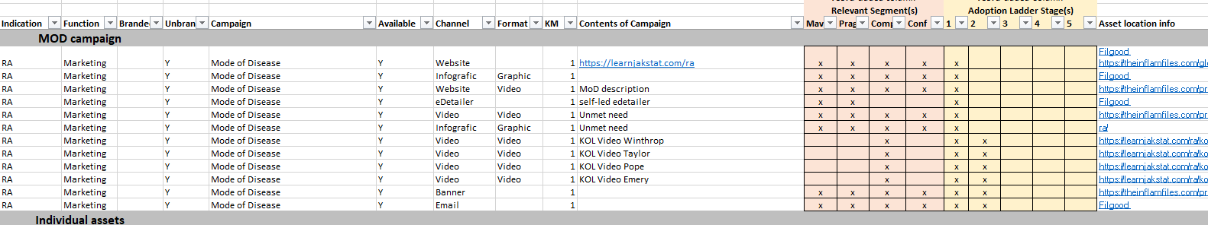
How do we get there: The Process
Brand / Strategy
Marketing / Medical Maps
Reps in-Market
Leverage existing Strategy:…
Develop the Journeys
Prepare Execution
Research | Segmentation | Channels | Content
The execution-focused mapping of the touchpoints with a HCP.
In Scope
Technology alignment with CRM and CDP
International, illustrative versions
Local, executable versions
Not In Scope
(But coming soon)
Rep execution training(Clare)
Journey orchestration pilots
Organise it for market clarity..

Slide 11
Project Phases
March |  |  | April | April |  |  | May | May
15 | 22st (1) | 29th (2) | 5th (3) | 12th (4) | 19th (5) | 26th (6) | 3rd (7) | 10th (8) | 17th (9) | 24th (10)
Project Management
Create Customer journey maps
1
Phase 1b
Build & Test Regional HJ Maps
Phase 1c
Detailed Localization of HJ Maps for France, Germany, UK, Spain, Italy
Phase 1d
Finalized Localization of HJ for NL and BelLux
Phase 1a
Foundations for HCP J Maps
Align maps with CRM/CDP
2
Phase 2a
Define Alignment between CJ Maps & CRM/CDP
Phase 2b
Build action plan to operationalize alignment
Mobilization
Build HCP journey map understanding
3
Phase 3a
Build Tactic Plan
Phase 3b
Build e-learning module
Phase 3c
Train the Trainer (CJ Market Champions)

Slide 12
Who (so far)
Secil – Sponsor
Eeva – RA Lead
DDB - Knowledge
Camille - Research
Johan/Boris/Clare – Advising for tech alignment and Rep execution

Slide 13
The progress so far

Slide 14
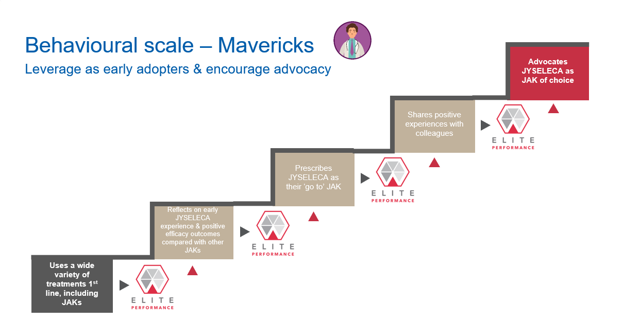
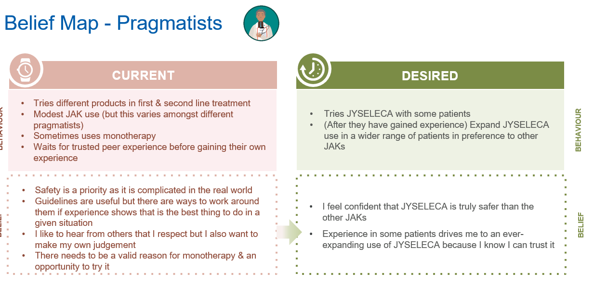
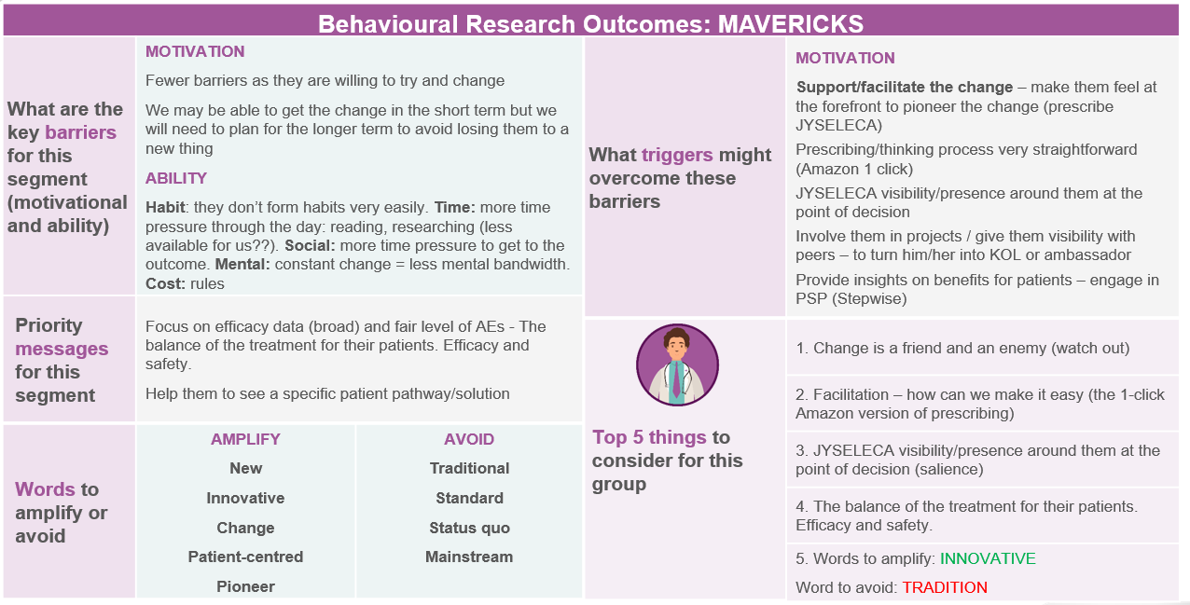
Adoption Ladder
Cheat Sheet & Additional Granularity

Slide 15
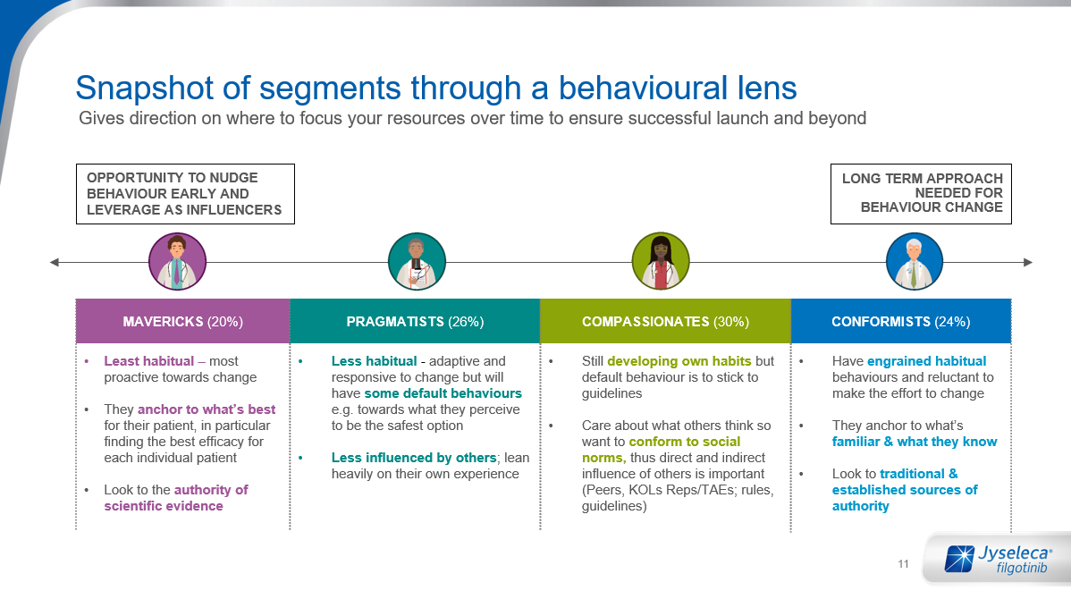
Segmented Content
Assets developed or in progress by the international team are designed to meet JYSELECA objectives and convey key messages. As key messages are aimed at specific segments, assets are therefore segmented as well.

Slide 16



Behaviour Change
CURRENT
Uses a very broad spectrum of products including JAKs
Uses very recently launched products
Able to talk extensively about new and pipeline treatments
Willing to act ahead of guidelines
DESIRED
Tries JYSELECA with some patients
(After they have gained experience) Expand JYSELECA use in a wider range of patients in preference to other JAKs
Unmet Need
Research
1st Rx
Prescribes
Advocates
Adoption Stage
#1
#2
#3
#4
#5
Mavericks: insert here
Pragmatists: insert here
Compassionates: Insert here
Galapagos Goal
Barriers
Mvrks
Messages
Prgmts
Cmpsts
Message Source
KOL Video
Study x
Guidelines

Slide 17
DESIRED
1
Behaviour Change
CURRENT
Uses a very broad spectrum of products including JAKs
Uses very recently launched products
Able to talk extensively about new and pipeline treatments
Willing to act ahead of guidelines
Tries JYSELECA with some patients
(After they have gained experience) Expand JYSELECA use in a wider range of patients in preference to other JAKs
Unmet Need
Research
1st Rx
Prescribes
Advocates
Adoption Stage
#1
#2
#3
#4
#5
High-Level Goal
To demonstrate that despite new treatments, unmet needs still remain, especially related to a balance of efficacy and safety
Segmented Goals
Mavericks: Uses a wide variety of treatments 1st line, including JAKs
Pragmatists: Occasionally uses JAKs but not consistently [high variation within segment – some are very high JAK users]
Compassionates: Uses a variety of products based on patient need & guideline recommendations
High-Level Goal
To ensure early positive experiences as proof of concept (and to share with peers)
Segmented Goals
Mavericks: Reflects on early JYSELECA experience & positive efficacy outcomes compared with other JAKs
Pragmatists: Attends a peer-to peer discussion with local colleagues about their experiences with JYSELECA & its safety profile
Compassionates: Attends a discussion with local expert about their experiences with JYSELECA & its safety profile
High-Level Goal
To differentiate JYSELECA versus other JAKs, especially RINVOQ
Segmented Goals
Mavericks: Prescribes JYSELECA as their ‘go to’ JAK
Pragmatists: Prescribes JYSELECA for some patients where safety is the main concern
Compassionates: Prescribes JYSELECA for some patients where safety & simplicity are important
High-Level Goal
To create an environment that facilitates exchange of positive experiences
Segmented Goals
Mavericks: Shares positive experiences with colleagues
Pragmatists: Gains depth of experience in patients where safety is a concern
Compassionates: Monitors feedback & safety signals in JYSELECA patients
High-Level Goal
To identify, support, and create a platform for JYSELECA advocates
Segmented Goals
Mavericks: Advocates JYSELECA as JAK of choice
Pragmatists: Expands the use of JYSELECA to different types of patients so ultimately JYSELECA becomes JAK of choice
Compassionates: Starts to use JYSELECA as first line JAK inhibitor
Galapagos Goal
Currently Unsegmented Barriers
Status Quo
Satisfied with current options
Complacency/habit/inertia
New MOA Required for Change
Don’t believe there are significant unmet needs that can be addressed by (another) JAK
Believe another MOA will be needed to address unmet needs
Patient-HCP Connection
Communication gap between patients and HCPs that masks unmet needs/treatment gaps (especially Compassionates)
COVID-19 context – access to care
Other
Highly competitive environment with comparisons between treatments hard to make.
Currently Unsegmented Barriers
Awareness & Access
Access to JYSELECA
Lack of access to sampling
Lack of experience with JYSELECA
Lack of familiarity with Galapagos and new relationship with reps
Differentiation
Perceived lack of differentiation from RINVOQ
Sees no difference in clinic relative to RINVOQ
Negative Safety Halo
Residual JAK concerns from 1st generation
Clinical
Has a negative experience in a patient in first few patients
Lack of clarity of who the ideal JYSELECA patient is
Currently Unsegmented Barriers
Satisfaction with Status Quo
Satisfaction with their current JAK and no reason to change
Prefer a Variety of Products
Prefer to have a wide armamentarium, rather than a go-to
Like to keep options open as new entries emerge
Lack of Clarity Around JYSELECA
Uncertainty around available JYSELELCA support services for HCPs and patients
Unsure of which patient population to expand usage in
Other
Competitive messaging and share of voice
Currently Unsegmented Barriers
Negative experiences that temper their enthusiasm
Wanting to appear unbiased/unaligned with a brand
Currently Unsegmented Barriers
Do not have a JAK of choice and philosophically opposed to aligning with one product
Don’t have a platform from which to advocate
Barriers
Notes:
#1
Mavericks lowest priority as they will already try new things on their own.
Pragmatists are using JAKs so we need to demonstrate that there is still a need for a new/different JAKi
#2
Mavericks are most likely be early adopters and also share their experience so we want to ensure they have early positive experience
Pragmatists tend to bend the rules to solve problems, focusing on safety provides a strong reason to believe
Compassionates will want to hear from and be reassured by peers so important to get the other two comfortable first
#3
Pragmatists most concerned with safety – need to differentiate on safety to achieve earlier us and differentiate against RINVOQ
Mavericks third because they will try anyway and also form their own opinion
#4 and #5
Pragmatists first because they are more likely to be long-term advocates
Mavericks second because want to keep them interested in JYSELECA by giving them a platform but they may move on to other products
Compassionates last because they will wait to hear from M and P – so we need M and P on board and sharing their stories

Slide 18
DESIRED
1
Behaviour Change
CURRENT
Uses a very broad spectrum of products including JAKs
Uses very recently launched products
Able to talk extensively about new and pipeline treatments
Willing to act ahead of guidelines
Tries JYSELECA with some patients
(After they have gained experience) Expand JYSELECA use in a wider range of patients in preference to other JAKs
Unmet Need
Research
1st Rx
Prescribes
Advocates
Adoption Stage
#1
#2
#3
#4
#5
Message Objective by Segment:
Mavericks: significant need for new treatment options – they already agree with this and are keen to try new options, esp if efficacy is not compromised
Pragmatists: need for more safe treatment options that do not compromise on efficacy
Compassionates: focus on unmet needs from a patient perspective – less from an HCP perspective
Message Topics:
Unmet needs messaging : 1/3 patients are refractory, EULAR guidelines, (5messages in total)
FAQ on CoVid impact
Message Objective by Segment:
Mavericks: expose to full data esp efficacy, give opportunity to try – make it easy, but they will be interested
Pragmatists: expose to full data incl safety, ref trusted peers/colleagues and hands on experience
Compassionates: KOL/Peer/trusted source perspectives on JYS safety and simplicity – ‘permission to try’
Message Topics
Now available
MoA : selectivity (vs 1G)
Comprehensive clinical evidence : 3 CT and long term data
Strength of balance story : full strength with safety)
Reimbursement : (to be localised)
Patient identification
HCP and Patient Support Service (Cpst) / to be localised)
Message Objective by Segment:
Mavericks: reinforce experience, share additional data freely, seed need to share with others
Pragmatists: advocate trial and follow up re experience and expansion of trial use
Compassionates: share/encourage patient feedback, patient perspectives, PIO
Message Topics
Efficacy
Safety
Patient Profiles
Patient identification
Corporate support
HCP and Patient Support Service
Message Objective by Segment:
Mavericks: provide opportunities to share experience and discuss with others
Pragmatists: expand patient types as experience is gained – give different ‘pegs
Compassionates: Monitors feedback & safety signals in JYSELECA patients
Message Topics
Efficacy
Safety
Patient Profiles
Patient identification
Corporate support
HCP and Patient Support Service
Message Objective by Segment:
Mavericks: KOL opportunities – keeping in mind loyalty can prob not be expected
Pragmatists: consolidate experience to lead to JAK of choice ‘peg’]
Compassionates: consolidate experience and ptn feedback to lead to JAK of choice ‘peg’ and 1L use
Message Topics
Corporate support
HCP and Patient Support Service
Partnership opportunities
Messages
Message Source
Please refer to Brand Content Asset Overview
Please refer to Brand Content Asset Overview
Please refer to Brand Content Asset Overview
Please refer to Brand Content Asset Overview
Please refer to Brand Content Asset Overview

Slide 19



Market Engagement
Updates & Progress
RA: Bought into the value of the journeys, the first market workshop is 20th April
RA: Bought into the value of the journeys, currently scheduling market workshops
RA: MOC Meeting scheduled for April 22nd
Others
RA: Spain alignment scheduled for April 23rd
Italy & BeneLux alignment is TBC

Slide 20
Appendix

Slide 21
HCP Channel Preference - Navigator Summary
HCP Channel Preference by country has been reviewed and summarized in order to add additional context when prioritizing channels for use in the HCP Journeys
 | Owned - Commercial | Owned – Medical | Paid | Earned
Regional Winners | F2F Reps: Viewed as high reach for this category across markets Pharma Website/ Emails/ eNewsletters: perceived generally as high reach/low impact | Pharma Webcasts: Very high reach scores (mid-impact) across multiple markets Scientific Meetings Medical Education | eCME: consistently scored high on impact & reach Scientific Websites/ Newsletters/ Search Engines (i.e. 3rd party) | Medical Journals International or National Congresses
Key Findings | Perceived Value of Sample Service differs significantly across markets. Responses show this category to be primarily useful for reach | MSL F2F scores flux across markets Patient support services scores flux across markets | Banner, TV ads, and Journal ads generally score very low on both metrics | KOLs score generally highly on impact and very low on reach Treatment Guidelines: Although high across markets, scores in IT & ES significantly higher than the other channels
Order of Impact
Earned
Paid
Owned-Medical
Owned-Commercial
Background: Channels were grouped into the four following categories: Owned- Promo “Commercial”, Owned – Medical, Paid, and Earned

